Slide 1
Chapter 3
Chapter 4
Chapter 5
Chapter 6
Chapter 7
Signal Quality Evaluation
QRS detection algorithms
Database Benchmarking
Heart Rate Variability
Implementation
Wiz Shirt, Version 1 and 2
Admos Live
Water, no water and electrode gel
SQI, Wiz shirt Version 1 and 2 comparison
Real time detectors , state of the art :
Pan Tompkins, Christov, Gamboa, Engelse and Zeelenberg (modified), Elgendi, Kalidas
Preliminary assessment
Alternative R-peak implementation
FieldWiz Database
SignalBit for annotations
Benchmarking:
Physionet Databases: Benchmarking
FieldWiz: Parameter Optimization
FieldWiz: Benchmarking
Artefact correction:
Detrending
Kubios artefact correction
Corrected RR-intervals 20% deviated from the median
HRV metrics:
SDNN, RMSSD, ln(RMSSD), LF, HF, LF/HF
Embedded implementation:
R-peak detection, RR-intervals and HR (corrected)
MATLAB implementation:
HRV metrics (SDNN, RMSSD, ln(RMSSD), LF, HF, LF/HF)

Slide 2
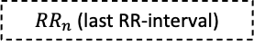
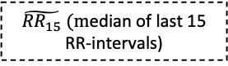
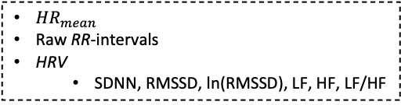
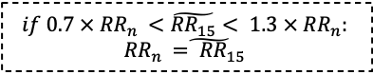
$\tilde{{RR}_{15}} (m$edian of last 15 RR-intervals)
R-peak detection
$$if{ 0.7 × RR}_{n }<\tilde{{RR}_{15}}< {1.3 × RR}_{n}:$$
$${RR}_{n }\tilde{{= RR}_{15}}$$
${RR}_{n}$(last RR-interval)
FieldWiz
(Embedded)
MATLAB
(Server)
R-peak detection:
RR-intervals
HR (instantaneous, median of the last 15 RR-intervals)
${HR}_{mean}$
Raw RR-intervals
HRV
SDNN, RMSSD, ln(RMSSD), LF, HF, LF/HF

Slide 3
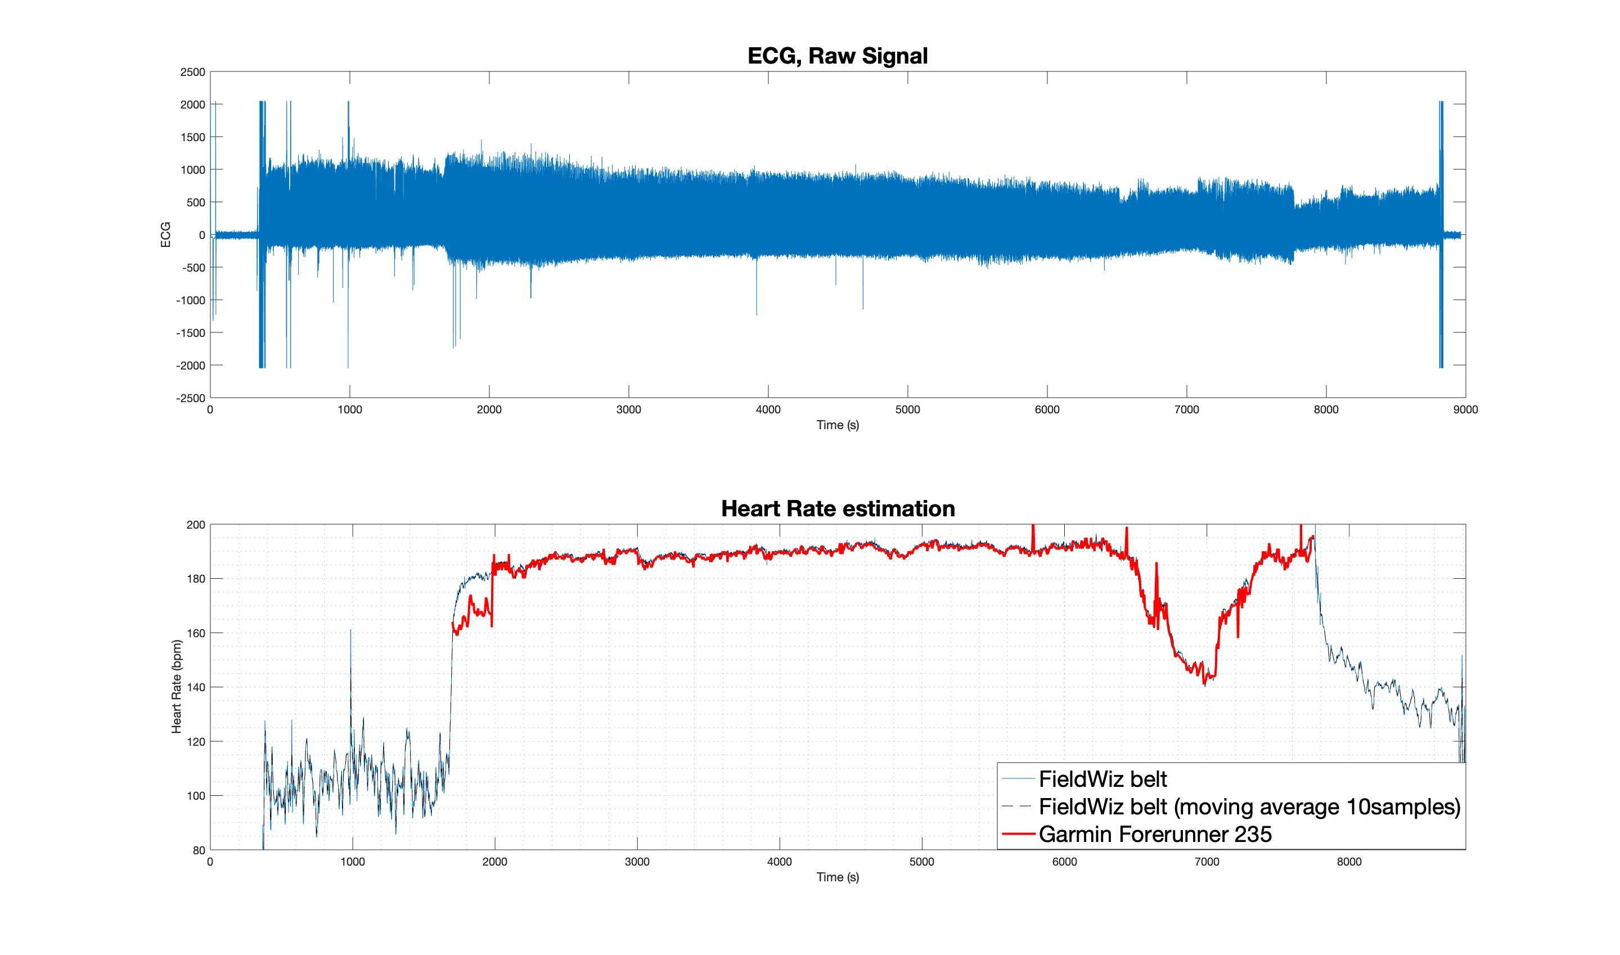
27/10/2019 Chest Strap
T_{i}
T₁
T₂
T_{f}
Lausanne Half Marathon 2019. Top) Raw ECG signal from FieldWiz chest strap; Bottom) Heart Rate estimations from 1) FieldWiz chest strap, 2) FieldWiz chest strap, 10samples moving average and 3) Garmin Forerunner 235.
T_{i}) Beginning of the Half-Marathon; T_{f}) End of the Half-Marathon; T₁) Stop running; T₂) Start running.

Slide 4
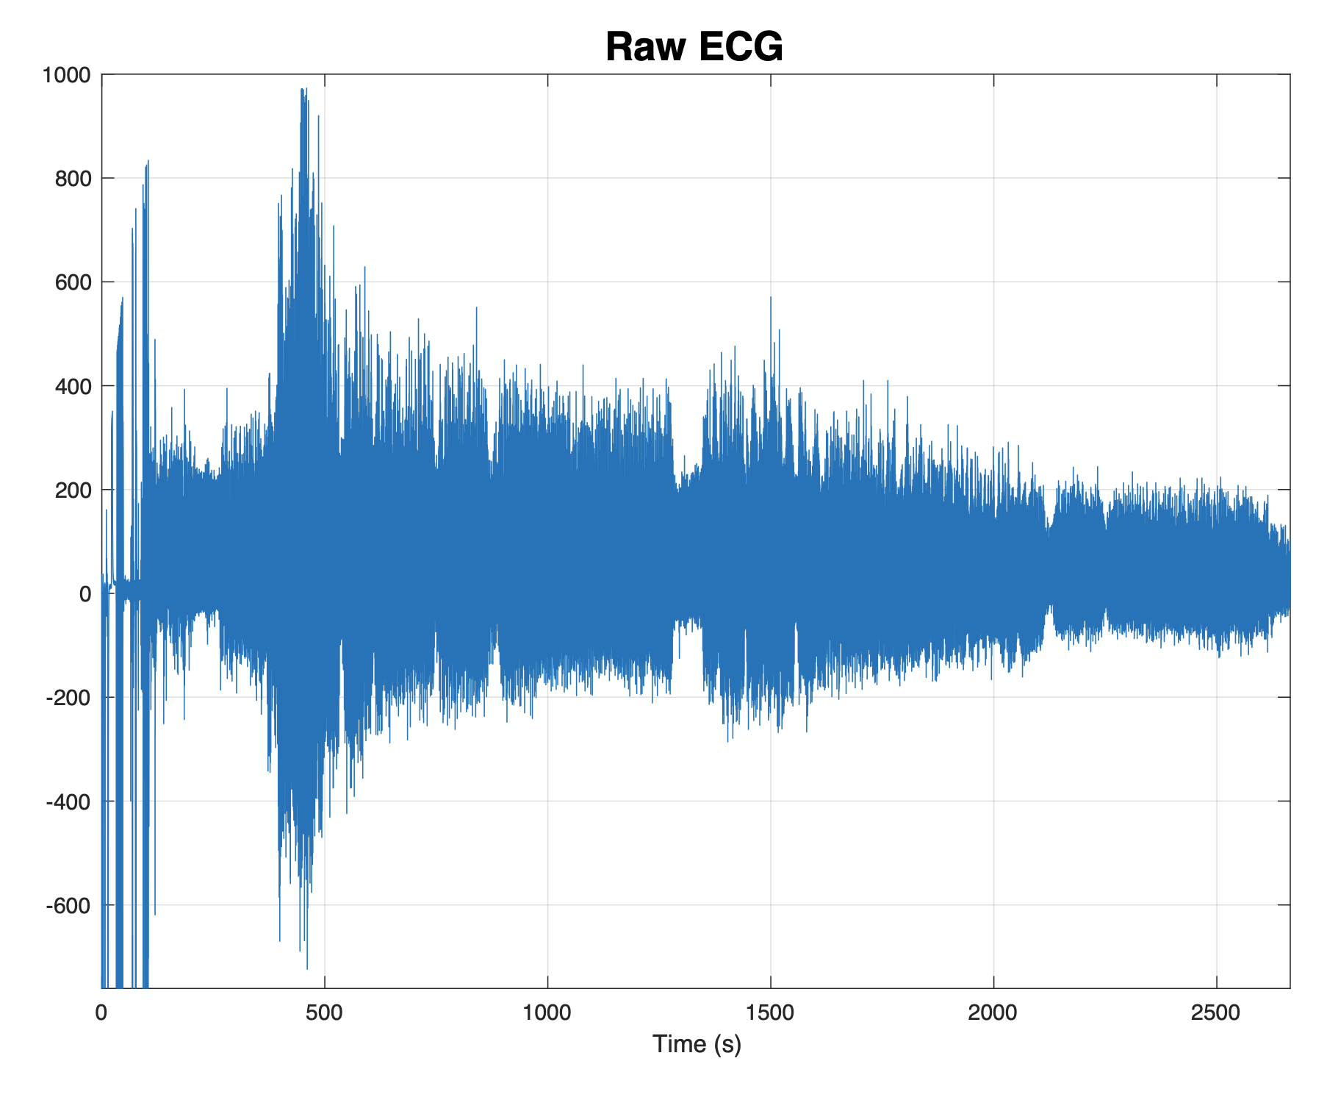
05/02/2020 T-shirt (old version)
1
2
3
4

Slide 5
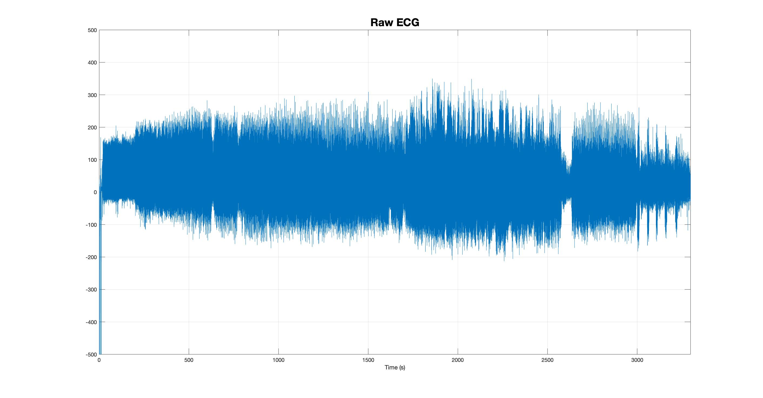
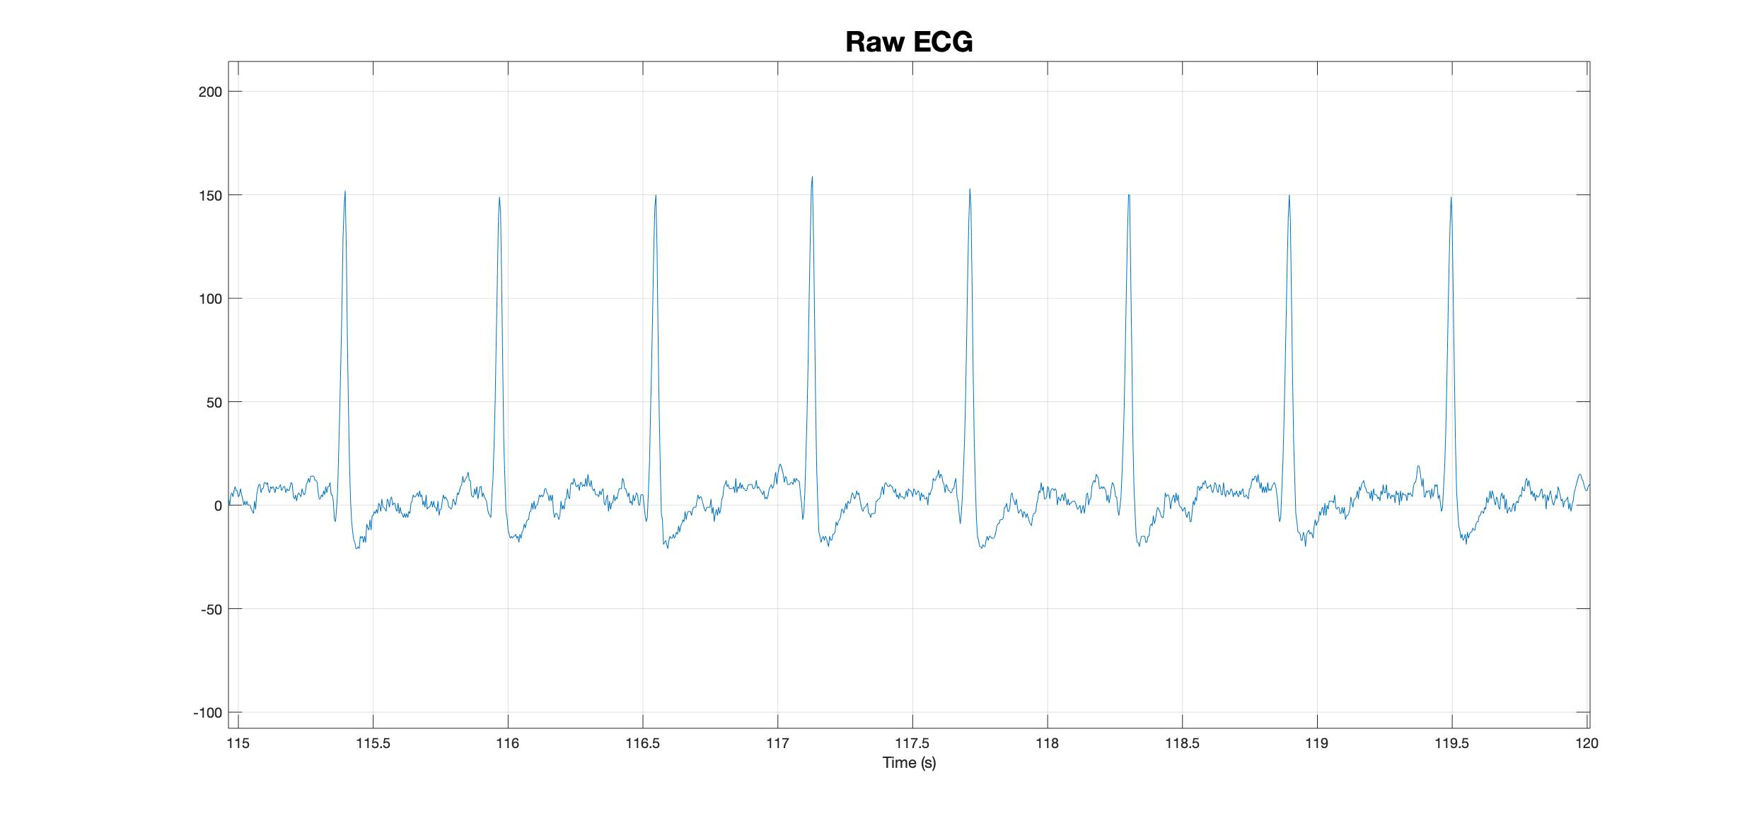
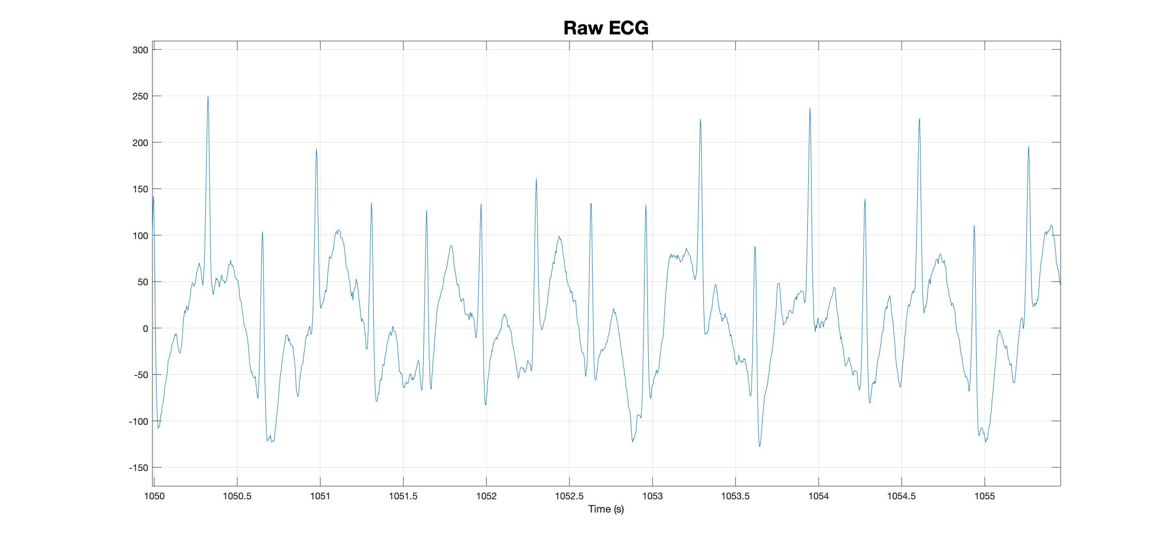
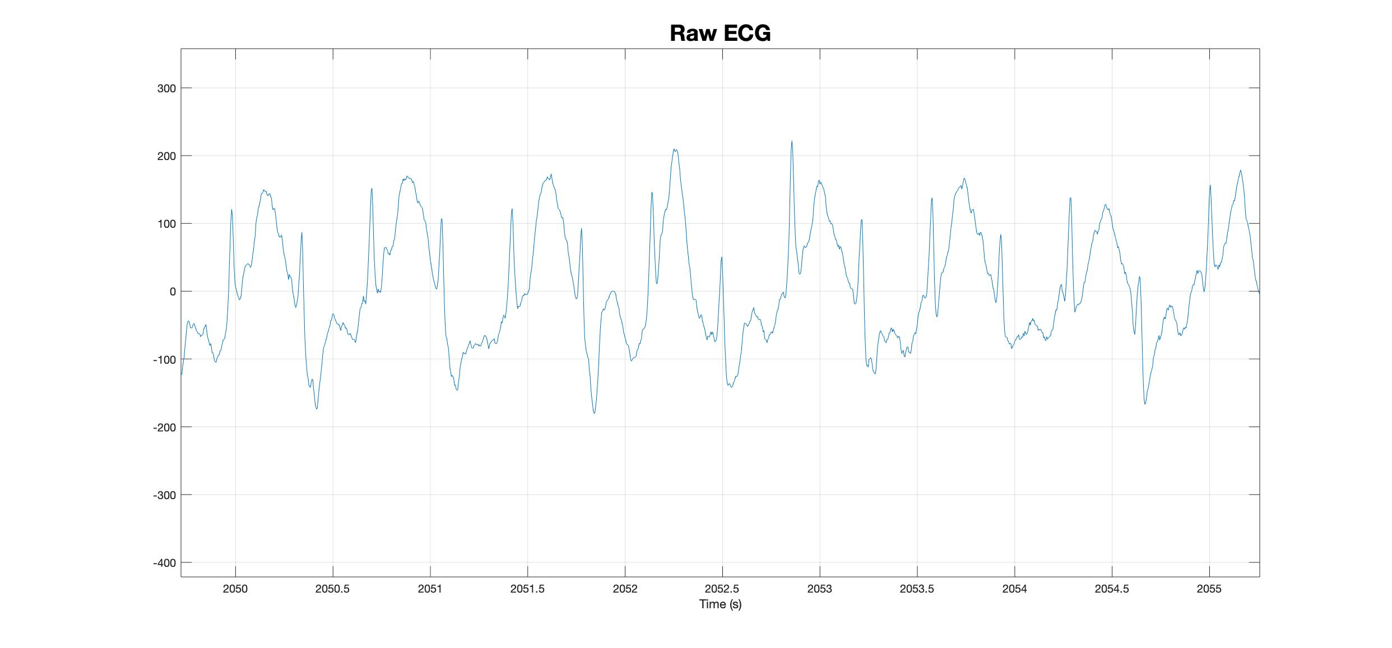
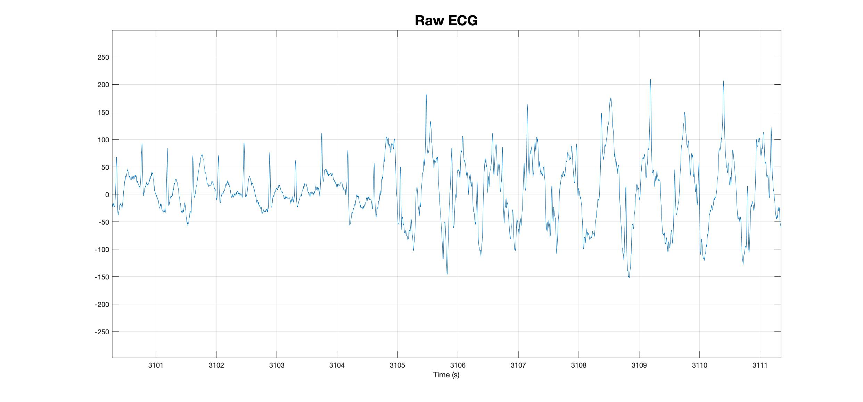
06/02/2020
1
2
3
4

Slide 6
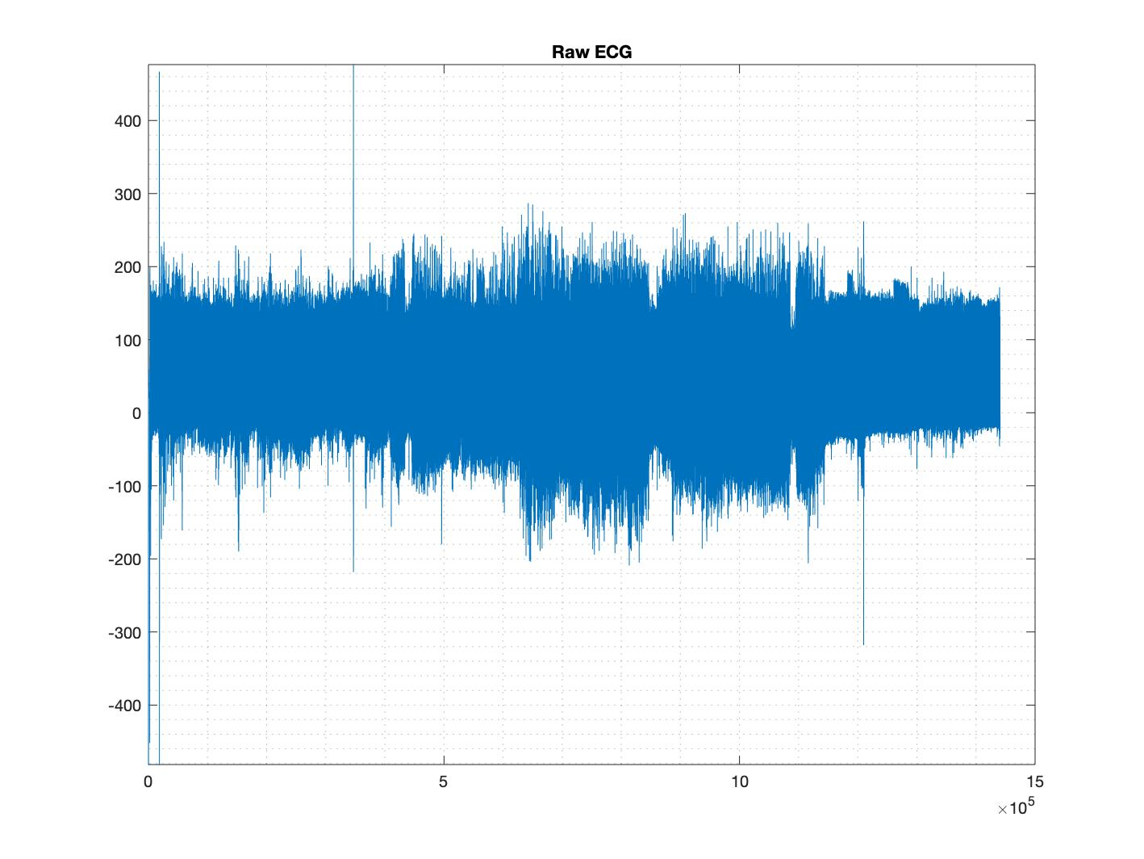
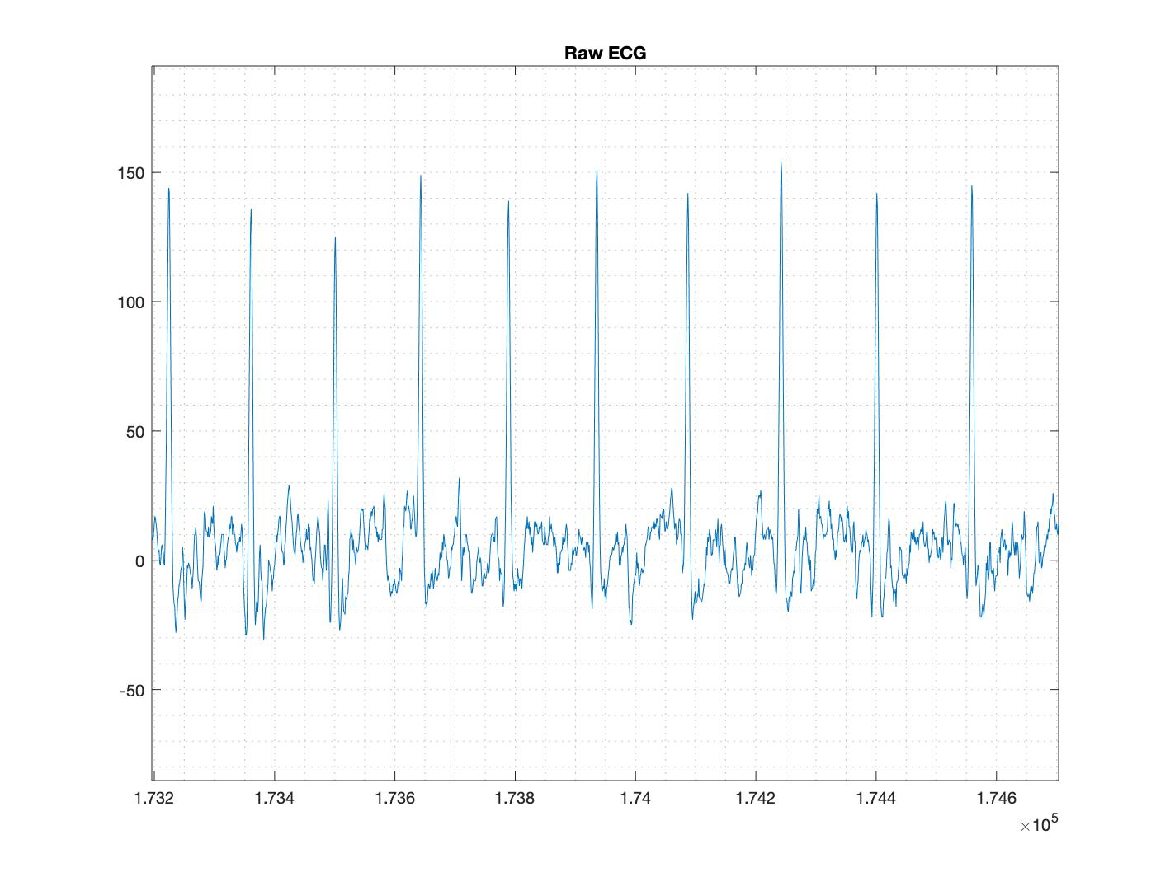
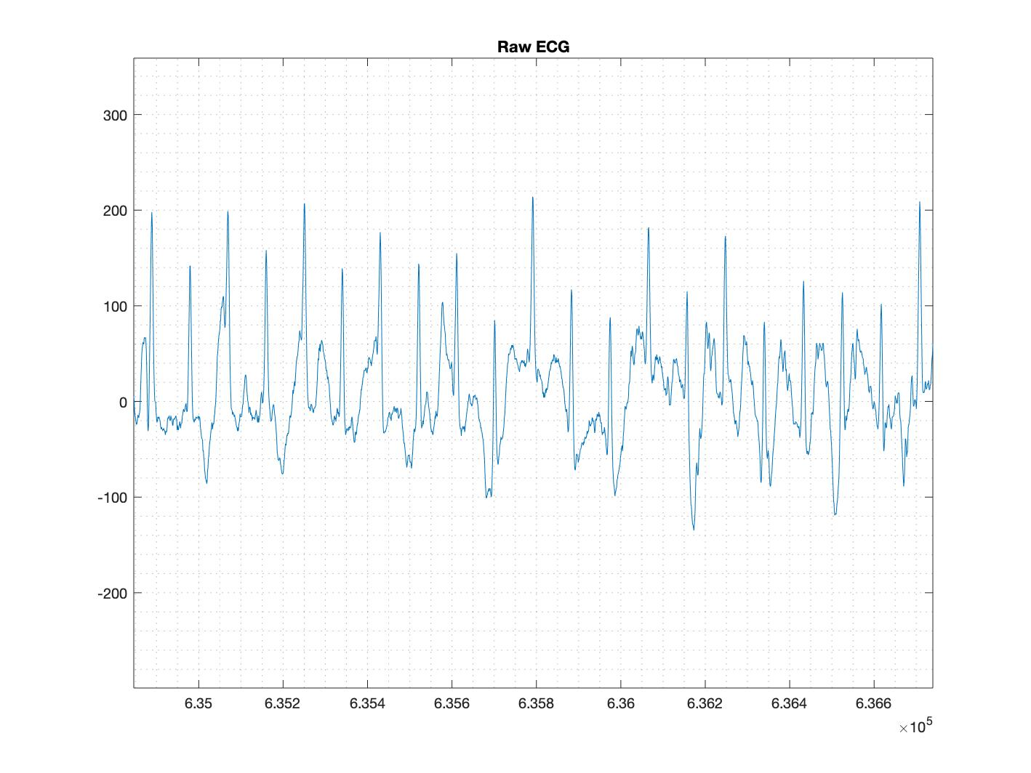
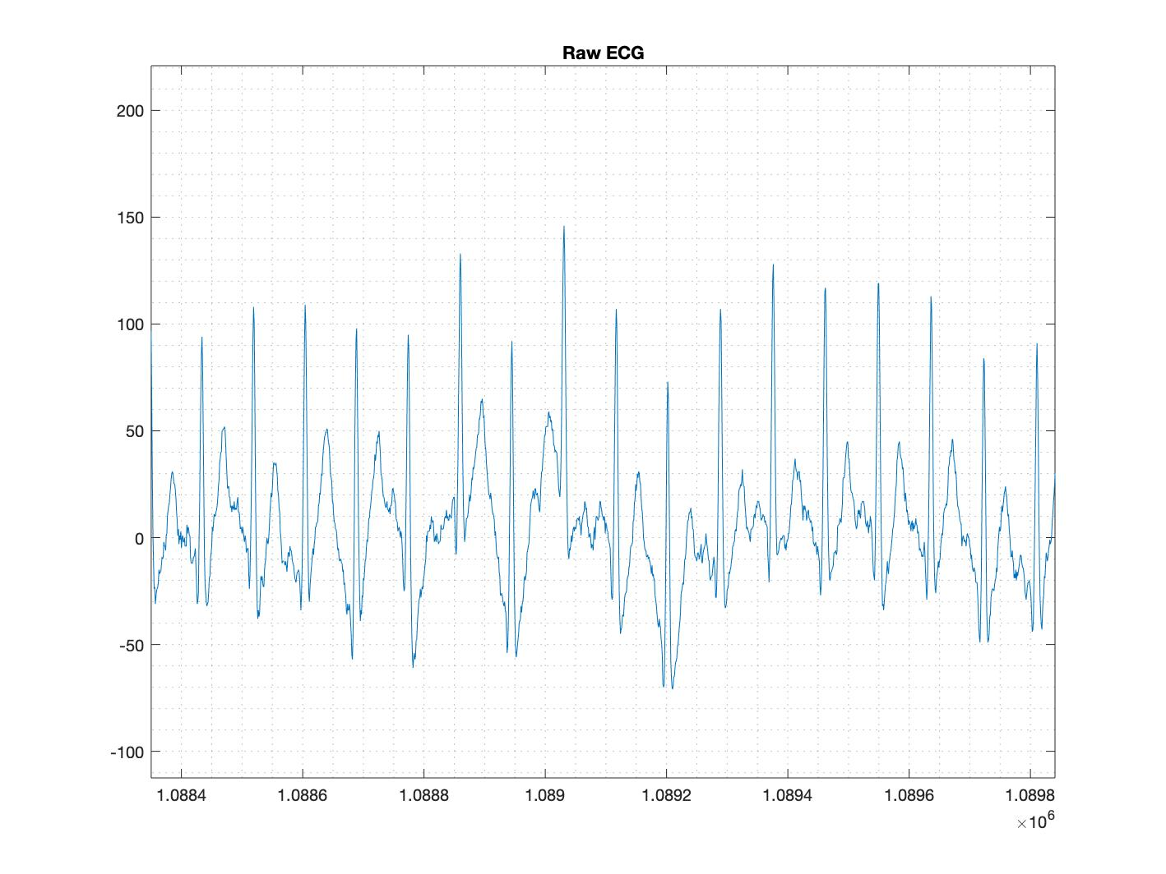
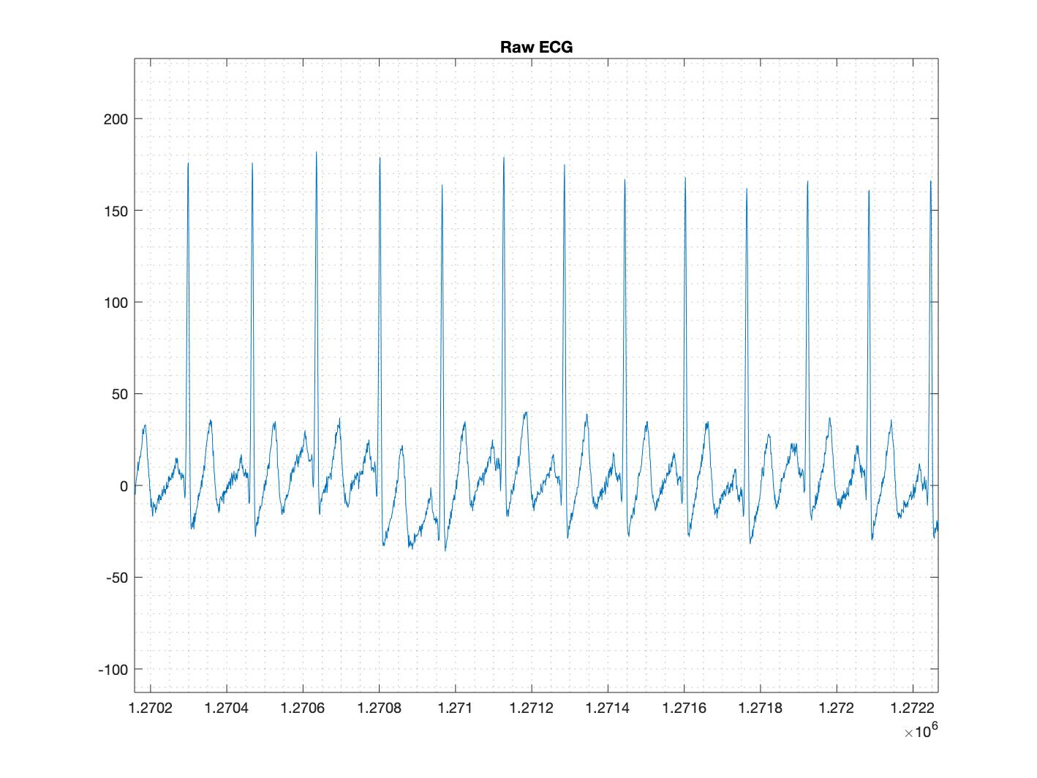
24/02/2020; New Shirt + Electrode Gel

Slide 7
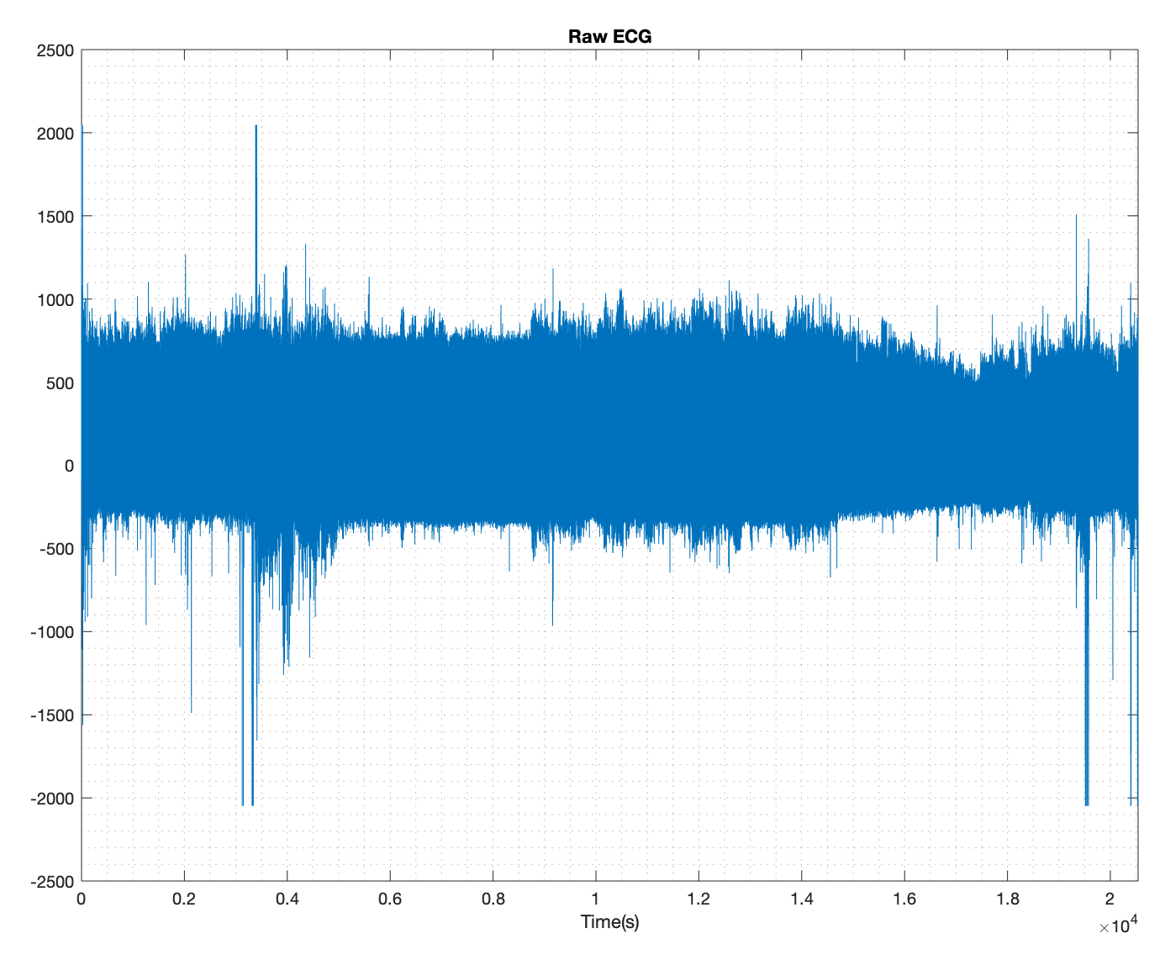
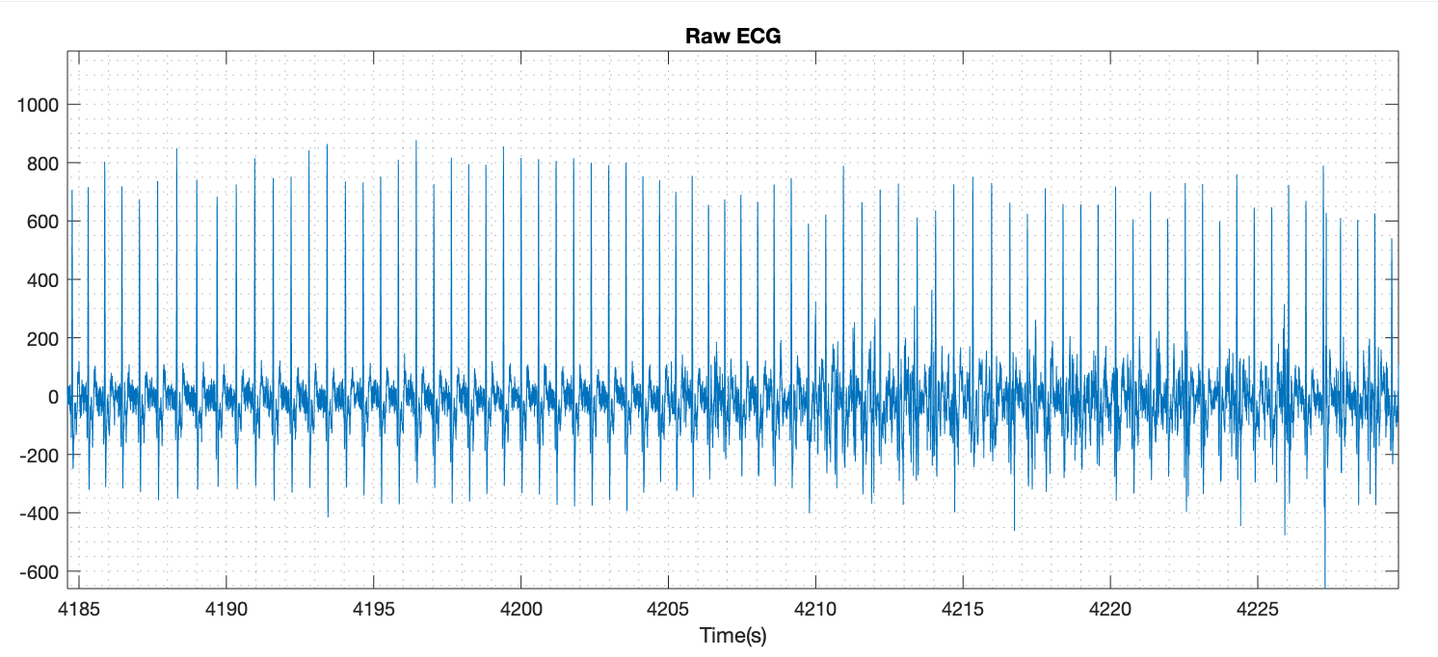
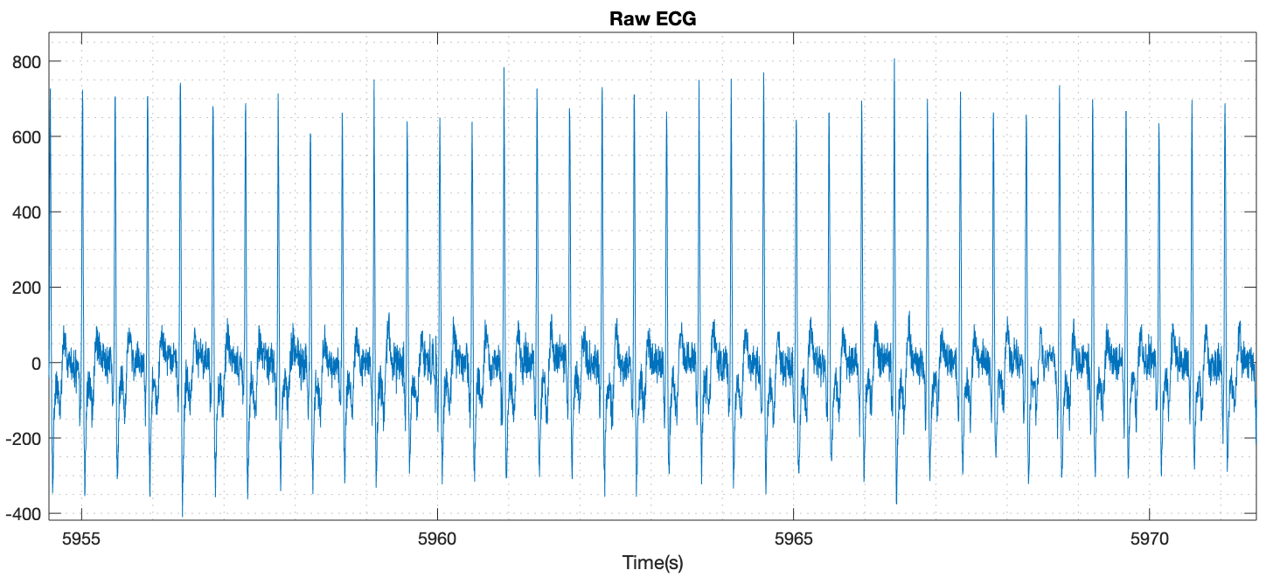
18/02/2020; New Hardware

Slide 8
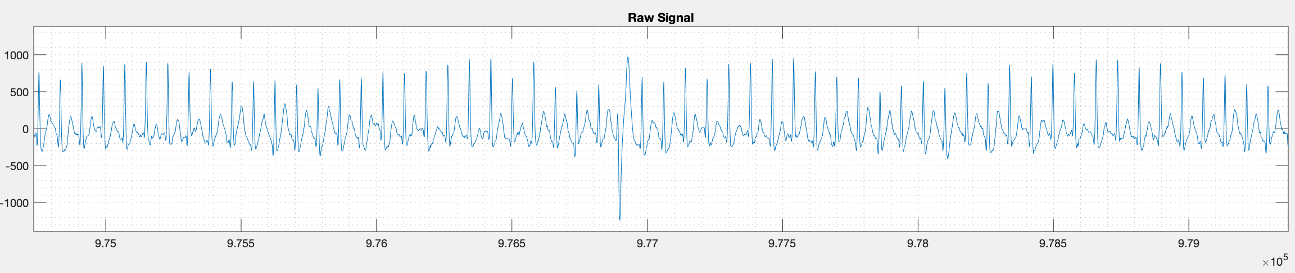
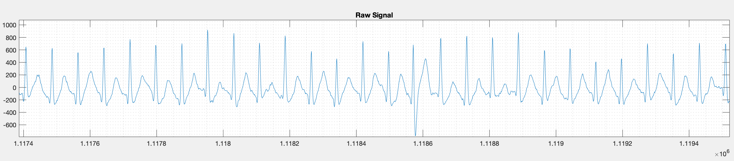
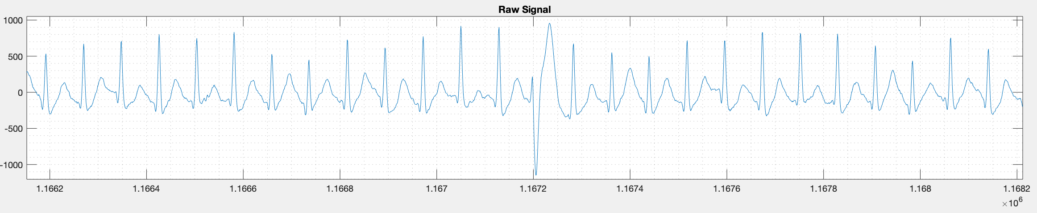
Ectopic heartbeat

Slide 9
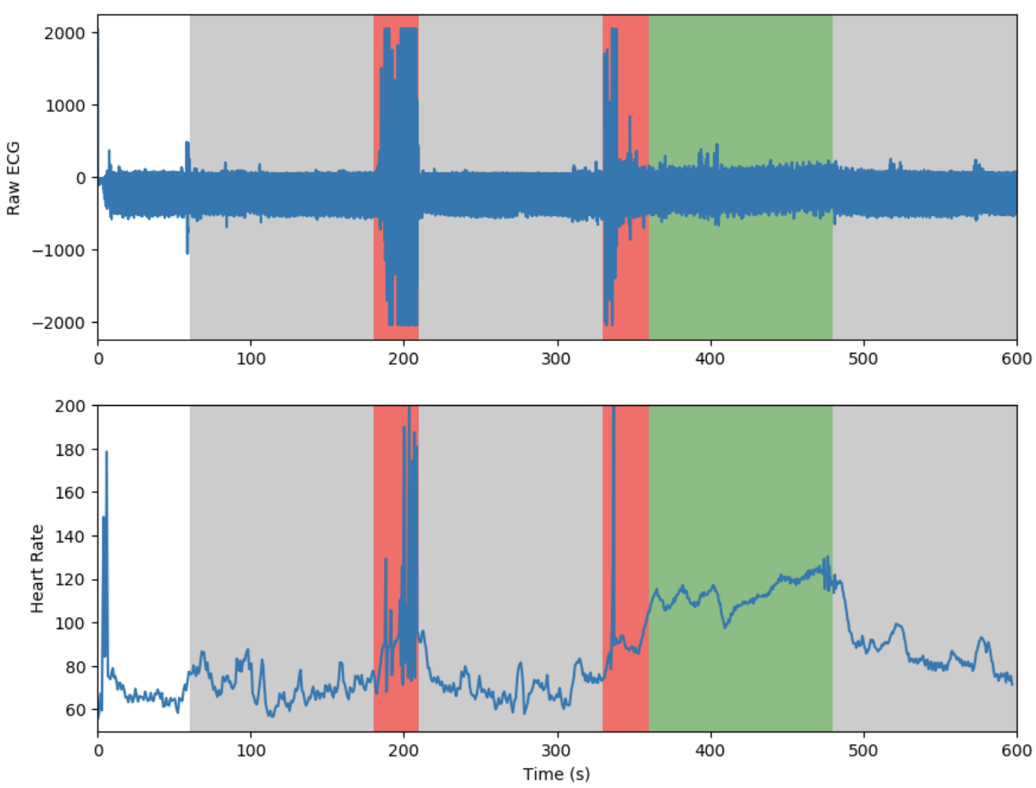

Slide 10
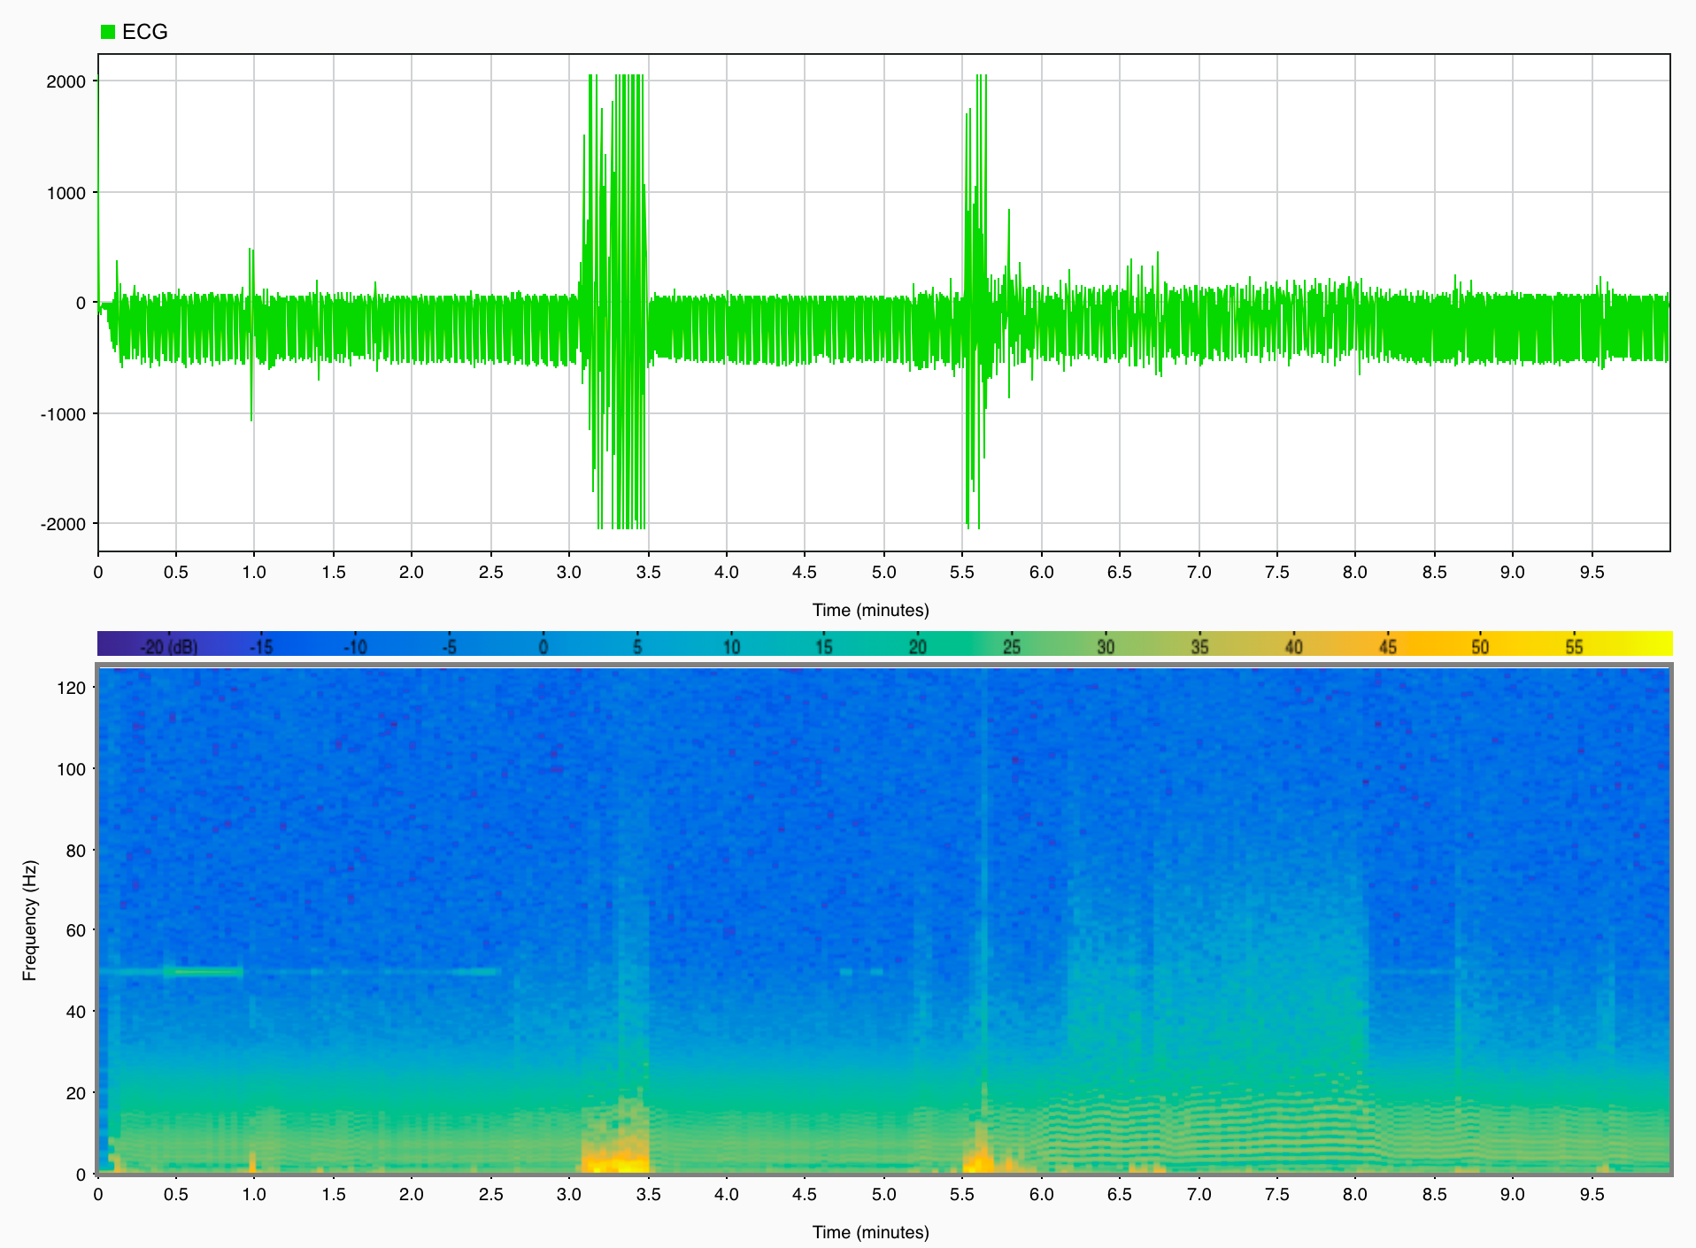

Slide 11
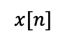
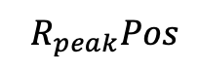
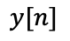
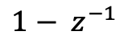
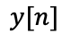
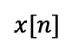
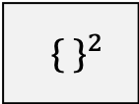
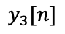
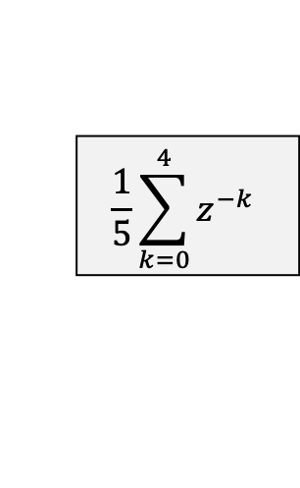
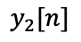
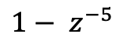
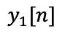
Algorithm (modification)
$$x[n]$$
Pre-Processing Stage
Derivative Derivative Squaring Integral
$$y[n]$$
Detection Stage
R peak detection based
on adaptive threshold
$${ R}_{peak}Pos$$
${\{ \}}^{2}$
$$\frac{1}{5}\sum_{k=0}^{4}{z^{−k}}$$
$$x[n]$$
$${1− z}^{−5}$$
$$y_{1}[n]$$
$${1− z}^{−1}$$
$$y_{2}[n]$$
$$y_{3}[n]$$
$$y[n]$$

Slide 12
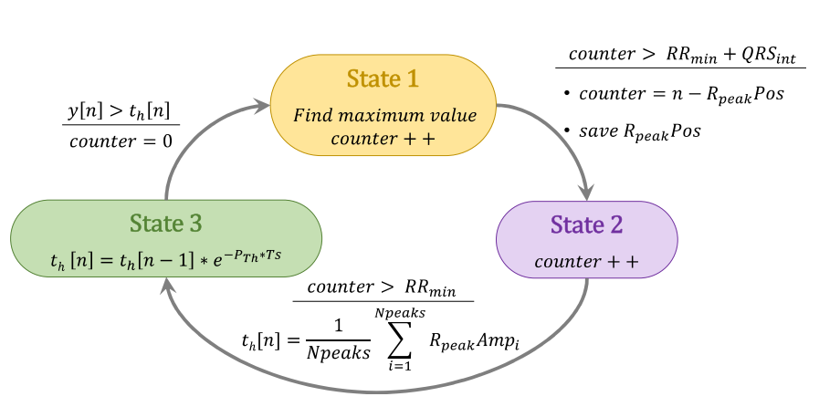
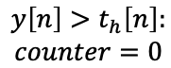
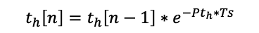
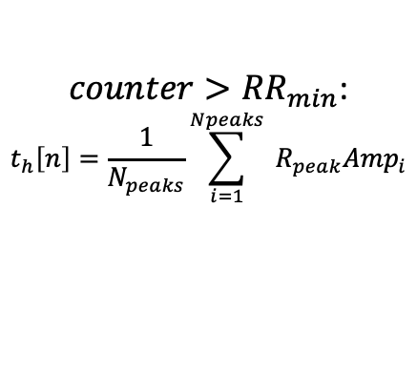
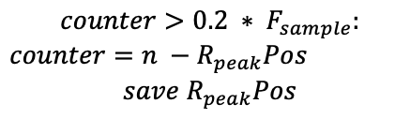
$$y\left[n\right]>t_{h}\left[n\right]:$$
$$counter=0$$
State 1
$$counter>0.2 ∗ F_{sample}:$$
$counter=n −R_{peak}Pos$
$$save{ R}_{peak}Pos$$
Search for R-peak
State 3
State 2
$t_{h}\left[n\right]=t_{h}\left[n−1\right]∗e^{−Pt_{h}∗Ts}$
Counter++
$counter>{RR}_{min}$:
$$t_{h}\left[n\right]=\frac{1}{N_{peaks}}\sum_{i=1}^{Npeaks}{{ R}_{peak}{Amp}_{i}}$$

Slide 13
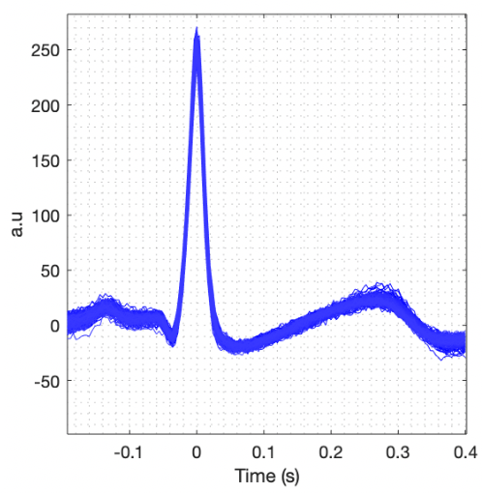
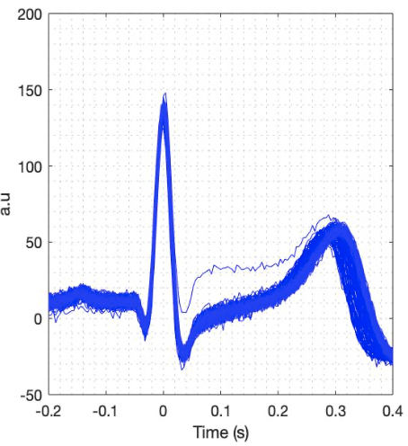
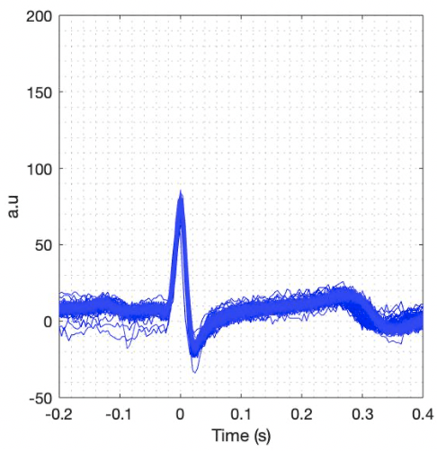
ECG Amplitude
ECG Amplitude
ECG Amplitude

Slide 14
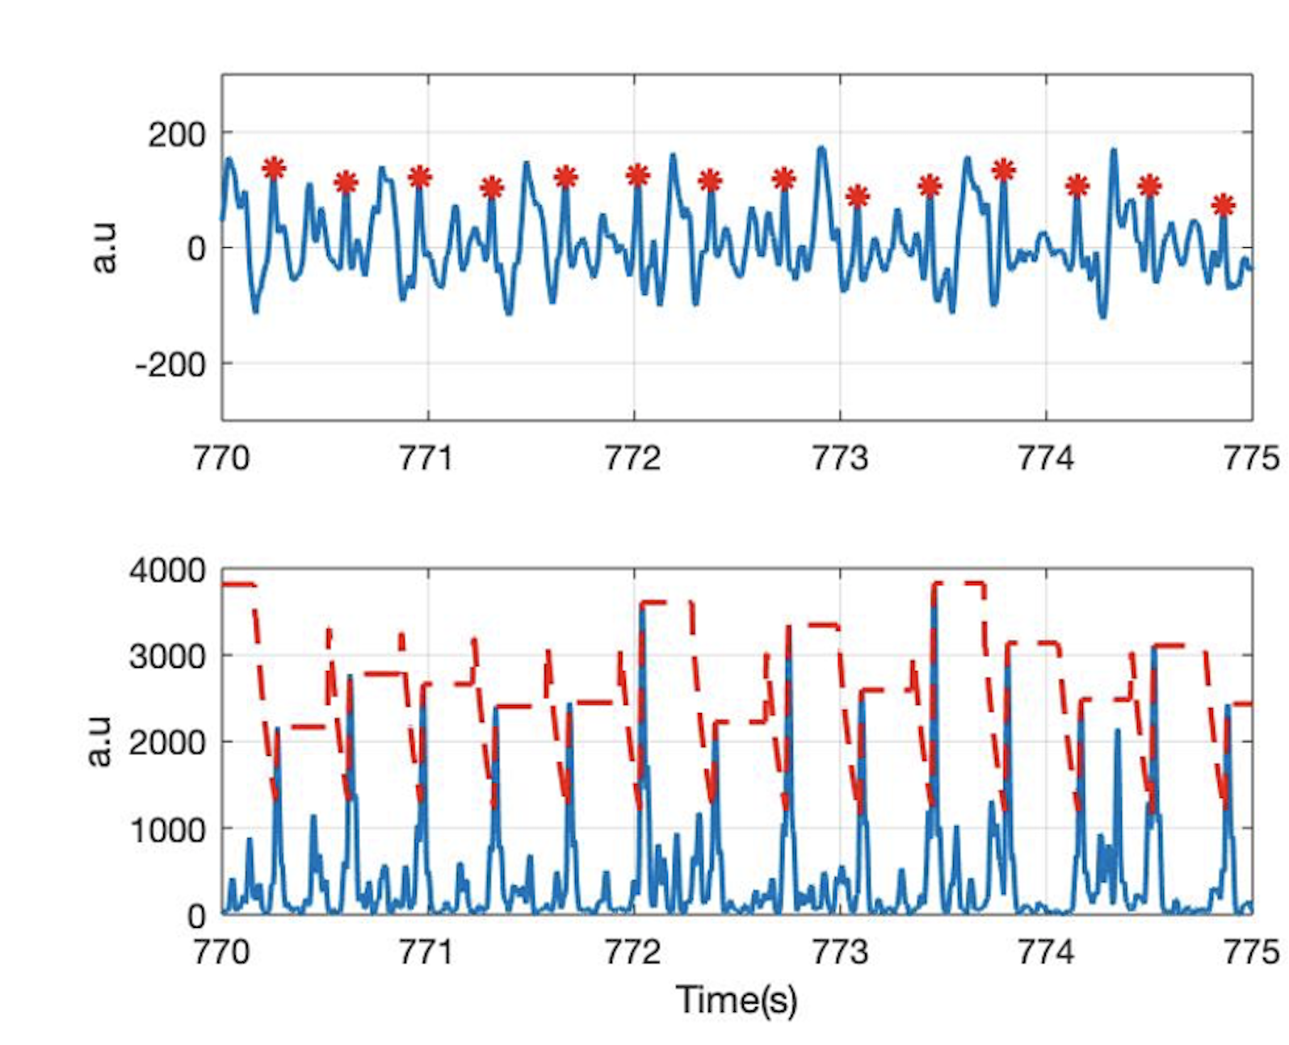
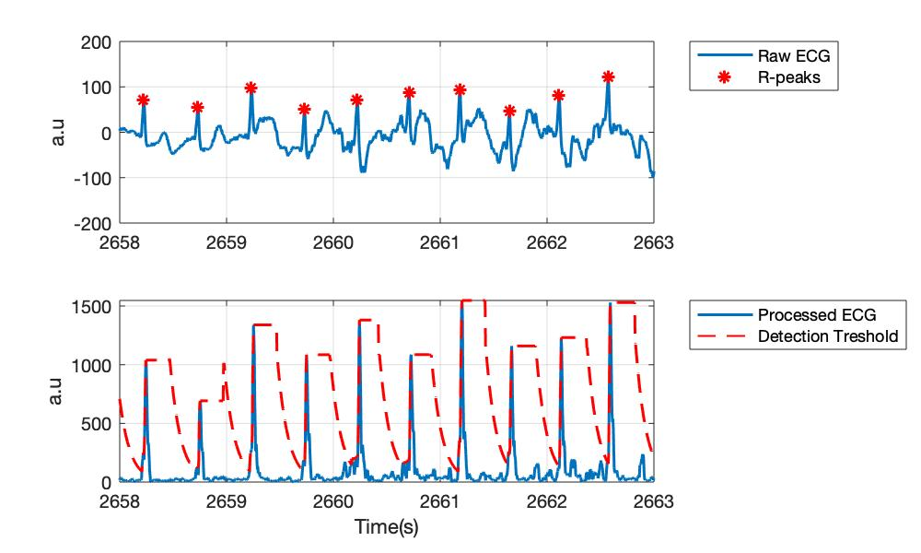
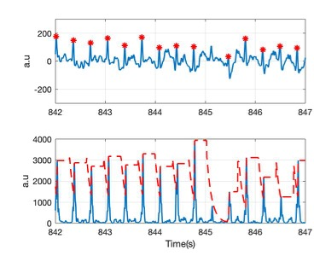
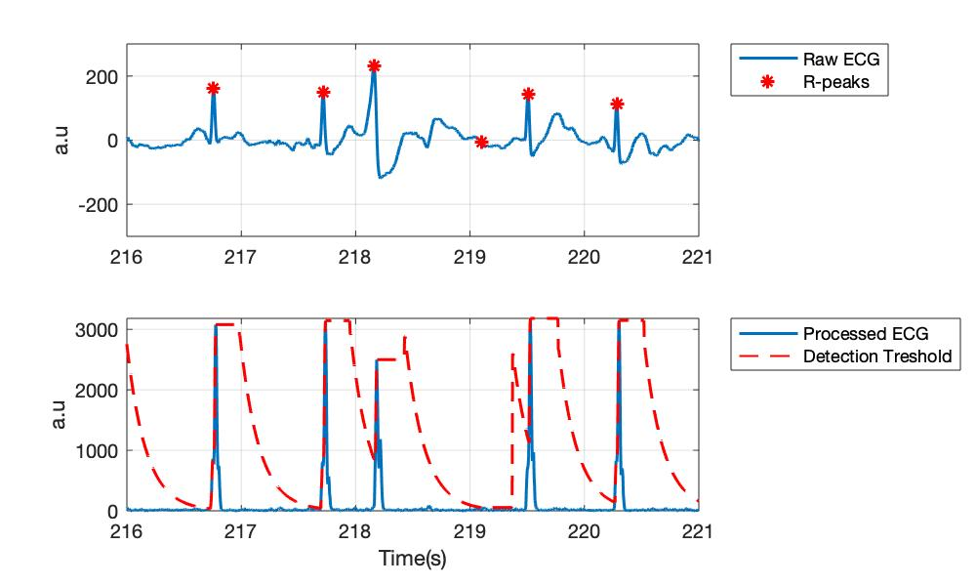
Raw ECG
Processed ECG
Raw ECG
Processed ECG

Slide 15
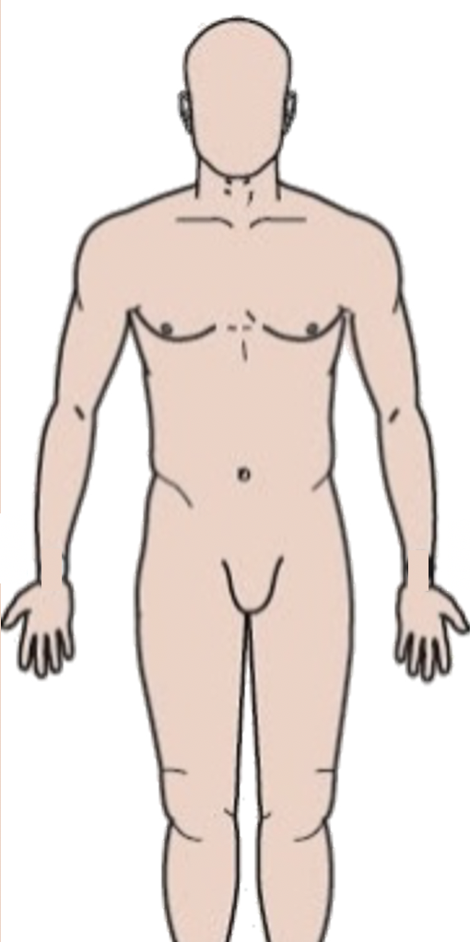

-
+
ECG electrodes
-
+
-
+
ECG electrodes
Shirt version 1
ECG electrodes Shirt version 2

Slide 16
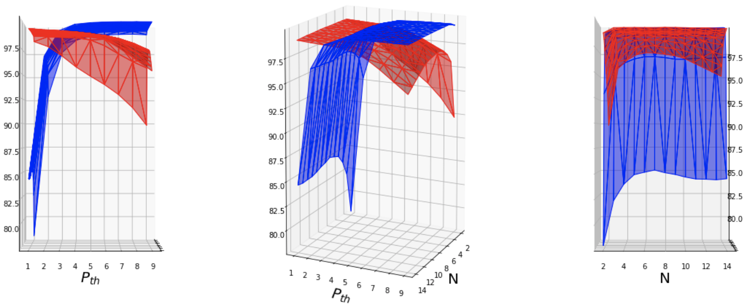


Slide 17


Slide 18






ADC Value
ADC Value
ADC Value
ADC Value
ADC Value
ADC Value

Slide 19

ADC Value
Heart Rate
Time (s)

Slide 20

ADC Value
Heart Rate
Time (s)

Slide 21
Raw ADC value
FIR [2,45]
fir(48, [2,45]/(250/2))

Slide 22



FieldWiz, Shirt Version 1
Noisy ECG
Good Quality ECG
Barely Acceptable
Barely Acceptable
Unacceptable
Unacceptable

Slide 23


FieldWiz, Shirt Version 2
Noisy ECG
Noisy ECG
Good Quality ECG
Good Quality ECG
Barely Acceptable
Barely Acceptable
Unacceptable
Unacceptable

Slide 24


